Slide 1
Payload Construction

Slide 2

Session Aims
To understand what makes a good payload chassis
To design and build a payload chassis which is both functional and stylish
You will need (per pair):
1 x payload kit & SD card
2 x SMA Antenna
1 x power source
Payload box / craft materials

Slide 3
Payload Requirements
Protect whatever it lands on
Protect contents against violence of descent and landing
Provide a base for mounting:
Tracker, camera, batteries (inside)
GPS Receiver (on top)
Radio aerial(s) (on bottom)
Nylon cord up to parachute
Protect contents from the cold. Keep holes to a minimum.
Look Pretty

Slide 4

Payload Materials
Polystyrene Foam
White - Makes a mess when cut. Soft. Available as sheets or preformed shapes (balls, eggs, boxes)
Pink/Blue - Heavier but stiffer. Snaps. Sheets only.
Craft knife / Stanley knife
UHU Por glue or hot melt (low setting)
Duct tape (many colours not just grey!)

Slide 5
Basic design
GPS
Tracker
Camera
Power
>164mm
Ground Plane
LoRa Aerial
Rtty Aerial

Slide 6
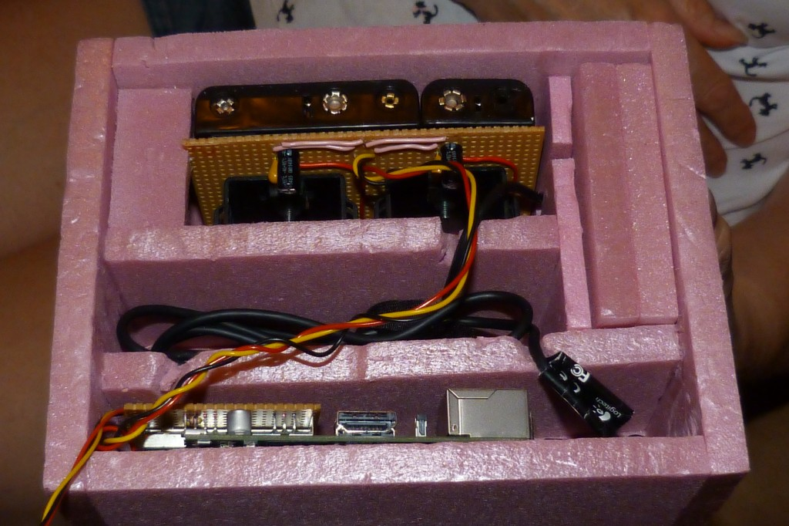

Slide 7
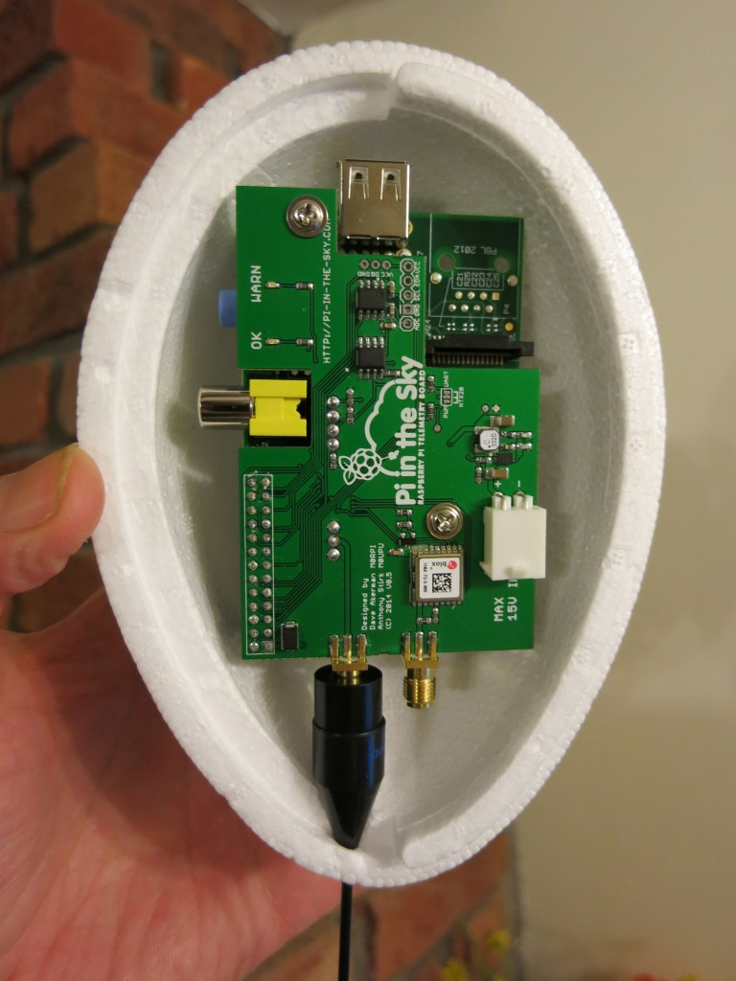

Slide 8
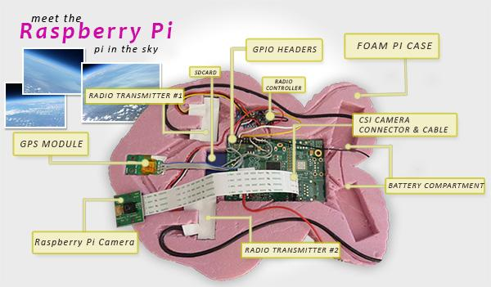

Slide 9
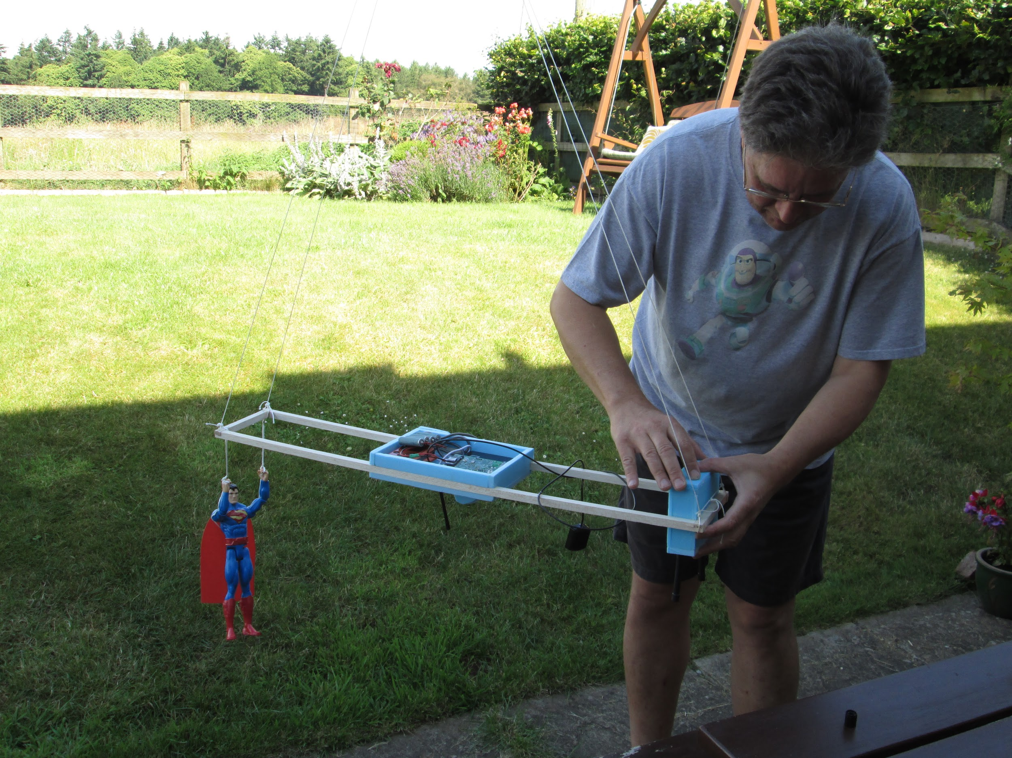

Slide 10
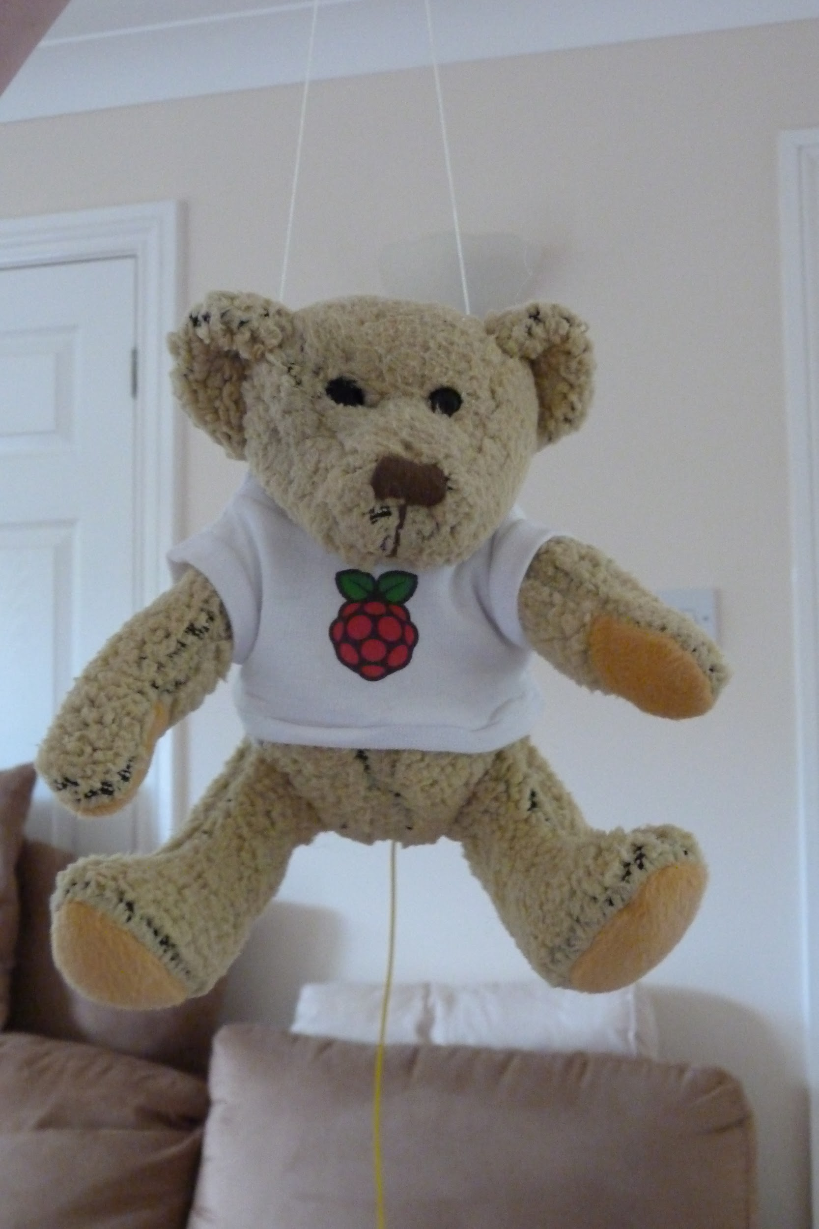

Slide 11
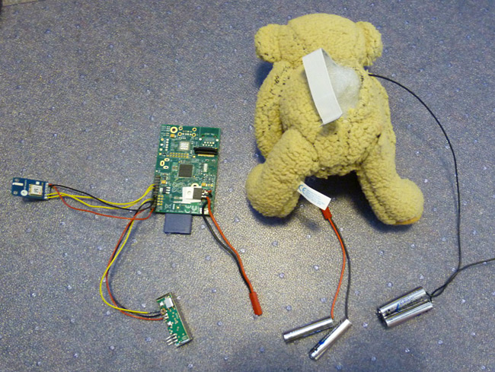

Slide 12
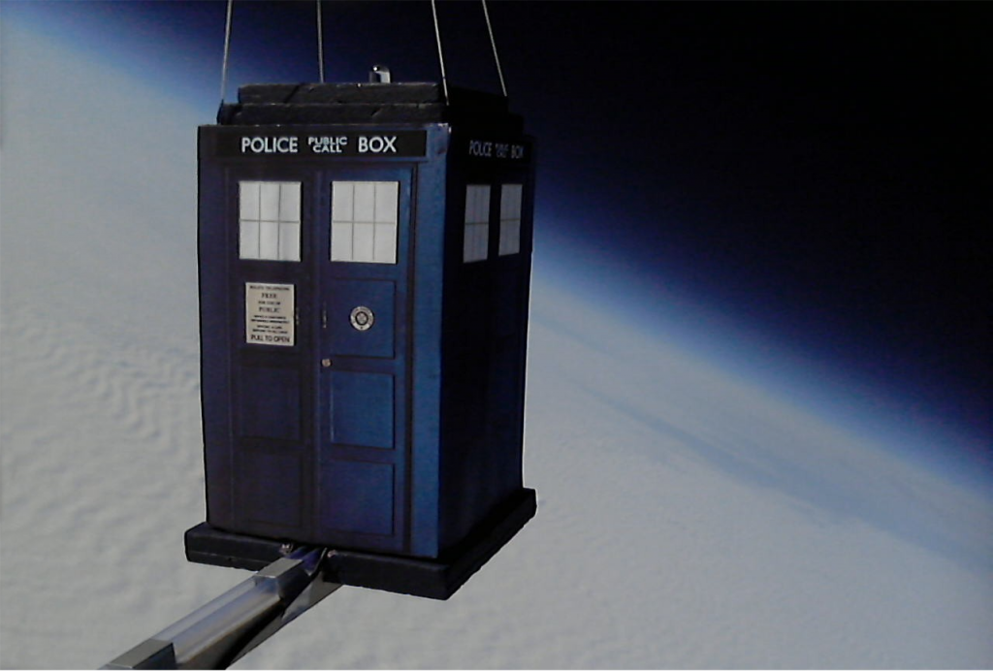

Slide 13
